Slide 1
Requirement engineering
Submitted by: Shraddha Mainali
Bim 6th Semester ‘B’
014BIM046
Submitted to: Bal Krishna subedi
lecturer
computer science department

Slide 2
contents
Objectives
Requirement engineering processes
Requirements engineering
Elicitation and analysis
Problems
Requirements elicitation and analysis process activities
Requirements discovery
Viewpoints

Slide 3
Viewpoint identification
Interviewing
Ethnography
Requirements validation
Requirements validation technique
Requirements checks
Requirements management
Summary
Reference

Slide 4
Objectives
To describe the principal requirements engineering activities and their d their relationships
To introduce techniques for requirements elicitation and analysis requirements elicitation and analysis
To describe requirements validation and the role of requirements reviews
To discuss the role of requirements management in support of other requirements engineering processes

Slide 5
Requirement engineering processes
The processes used for RE vary widely depending on the application domain, the people involved and the organization developing the domain, the people involved and the organization developing the requirements.
However, there are a number of generic activities common to all processes
Requirements elicitation;
Requirements analysis;
Requirements validation;
Requirements management.

Slide 6
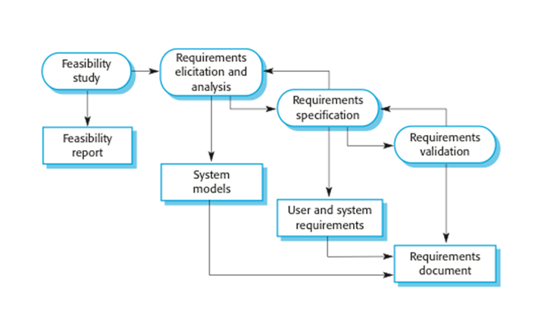

Slide 7
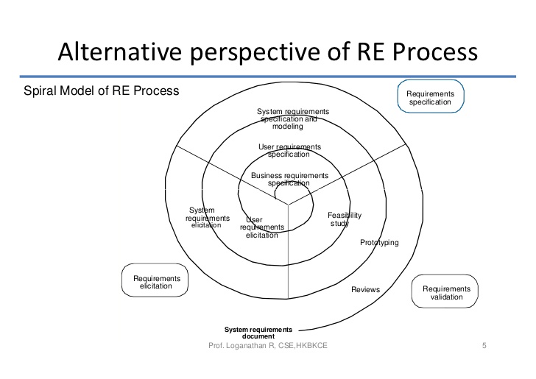
Requirements engineering

Slide 8
A feasibility study decides whether or not the proposed system is worthwhile.
A short focused study that checks If the system contributes to organizational objectives.
If the system can be engineered using current technology and within budget
If the system can be integrated with other systems that are used.
Feasibility study implementation is based on information assessment (what is required), information collection and report writing.

Slide 9
Elicitation and analysis
Sometimes called requirements elicitation or requirements discovery.
Involves technical staff working with customers to find out about the application domain, the services that the system should provide and the system’s operational constraints.
May involve end-users, managers, engineers involved in maintenance, domain experts, trade unions, etc. These are called stakeholders. stakeholders.

Slide 10
Problems
Stakeholders don’t know what they really want.
Stakeholders express requirements in their own terms. in their own terms.
Different stakeholders may have conflicting requirements.
Organizational and political factors may influence the system requirements.
The requirements change during the analysis process. New stakeholders may emerge and the business environment change.

Slide 11
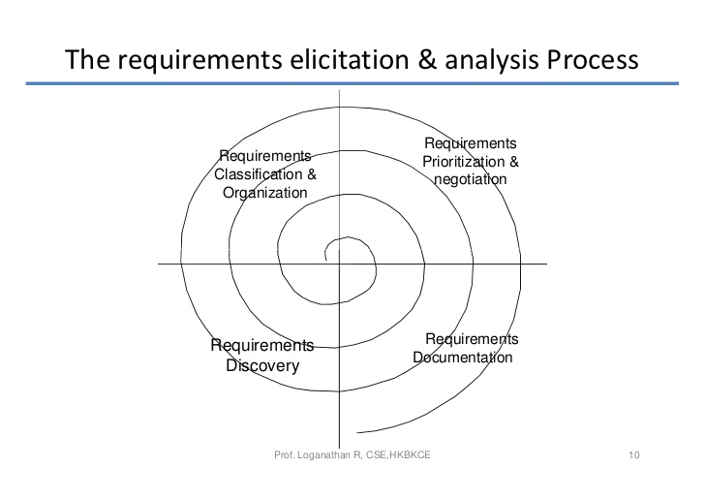

Slide 12
Requirements elicitation and analysis process activities
Requirements discovery
Interacting with stakeholders to discover their requirements. Domain requirements are also discovered at this stage.
Requirements classification and organization
Groups related requirements and organizes them into coherent clusters.
Prioritization and negotiation
Prioritizing requirements and resolving requirements conflicts.
Requirements documentation
Requirements are documented and input into the next round of the spiral. spiral

Slide 13
Requirements discovery
The process of gathering information about the proposed and existing systems and distilling the user and system requirements from this information.
Sources of information include documentation, system stakeholder and the specifications of similar systems.

Slide 14
viewpoints
Viewpoints are a way of structuring the requirements to represent the perspectives of different stakeholders. Stakeholders may be classified under different viewpoints.
This multi-perspective analysis is important as there is no single correct way to analyze system requirements.
Interactor viewpoints
People or other systems that interact directly with the system. In an ATM, the customer’s and the account database are interactor VPs. s
Indirect viewpoints
Stakeholders who do not use the system themselves but who influence the requirements. In an ATM, management and security staff are indirect viewpoints.
Domain viewpoints
Domain characteristics and constraints that influence the requirements. In an ATM, an example would be standards for inter-bank communications.

Slide 15
Viewpoint identification
Identify viewpoints using
Providers and receivers of system services
Systems that interact directly with the system being specified
Regulations and standards
Sources of business and non-functional requirements.
Engineers who have to develop and maintain the system
Marketing and other business viewpoints.

Slide 16
interviewing
In formal or informal interviewing, the RE team puts questions to stakeholders about the system that they use and the system to be developed. developed.
There are two types of interview
• Closed interviews where a pre-defined set of questions are answered.
• Open interviews where there is no pre-defined agenda and a range of issues are explored with stakeholders
Normally a mix of closed and open-ended interviewing.
Interviews are good for getting an overall understanding of what stakeholders do and how they might interact with the system.
Interviews are not good for understanding domain requirements

Slide 17
ethnography
A social scientists spends a considerable time observing and analyzing how people actually work.
People do not have to explain or articulate their work.
Social and organizational factors of importance may be observed.
Ethnographic studies have shown that work is usually richer and more complex than suggested by simple system models.

Slide 18
Requirements validation
Concerned with demonstrating that the requirements define the system that the customer really wants.
Requirements error costs are high so validation is very important.
Fixing a requirements error after delivery may cost up to 100 times the cost of fixing an implementation error.

Slide 19
Requirements validation
Validity.
Does the system provide the functions which best support the customer’s needs?
Consistency.
Are there any requirements conflicts?
Completeness.
Are all functions required by the customer included?
Realism.
Can the requirements be implemented given available budget and technology?
Verifiability
Can the requirements be checked?

Slide 20
Requirements validation technique
Requirements reviews
Systematic manual analysis of the requirements.
Prototyping
Using an executable model of the system to check requirements.
Developing tests for requirements to check testability.

Slide 21
Requirements checks
Verifiability.
Is the requirement realistically testable?
Comprehensibility.
Is the requirement properly understood?
Traceability.
Is the origin of the requirement clearly stated?
Adaptability.
Can the requirement be changed without a large impact on other requirements?

Slide 22
Requirements management
Requirements management is the process of managing changing requirements during the requirements engineering process and system development.
Requirements are inevitably incomplete and inconsistent.
New requirements emerge during the process as business needs change and better understanding of the system is developed.
Different viewpoints have different requirements and these are often contradictory.

Slide 23
summary
The requirements engineering process includes a feasibility study, requirements elicitation and analysis, requirements specification and requirements management
Requirements elicitation and analysis is iterative involving domain understanding, requirements collection, classification, structuring, prioritization and validation.
Systems have multiple stakeholders with different requirements.
Social and organization factors influence system requirements.
Requirements validation is concerned with checks for validity, consistency, completeness, realism and verifiability.
Business changes inevitably lead to changing requirements.
Requirements management includes planning and change management.

Slide 24
Reference
http://www.cs.ccsu.edu/~stan/classes/CS530/Slides/SE-07.pdf
https://images.search.yahoo.com/search/images;_ylt=AwrBT_t3ZIFZ8_sAn3pXNyoA;_ylu=X3oDMTB0N2Noc21lBGNvbG8DYmYxBHBvcwMxBHZ0aWQDBHNlYwNwaXZz?p=requirement+engineering&fr2=piv-web&fr=tightropetb#id=78&iurl=https%3A%2F%2Fimage.slidesharecdn.com%2Frequirementengineeringprocess-120928041506-phpapp01%2F95%2Frequirement-engineering-process-10-728.jpg%3Fcb%3D1348805777&action=click
https://images.search.yahoo.com/search/images;_ylt=AwrBT_t3ZIFZ8_sAn3pXNyoA;_ylu=X3oDMTB0N2Noc21lBGNvbG8DYmYxBHBvcwMxBHZ0aWQDBHNlYwNwaXZz?p=requirement+engineering&fr2=piv-web&fr=tightropetb#id=68&iurl=http%3A%2F%2Fcsis.pace.edu%2F~marchese%2FSE616_New%2FL4%2FL4_files%2Fimage016.png&action=click
https://images.search.yahoo.com/search/images;_ylt=AwrBT_t3ZIFZ8_sAn3pXNyoA;_ylu=X3oDMTB0N2Noc21lBGNvbG8DYmYxBHBvcwMxBHZ0aWQDBHNlYwNwaXZz?p=requirement+engineering&fr2=piv-web&fr=tightropetb#id=9&iurl=http%3A%2F%2Fwww.geocities.ws%2Fiare_it%2Fseunit3_files%2Fimage002.gif&action=click

Slide 25


